Slide 1
Improving physics-informed neural networks
based on the deep neural network architecture
①
②
③
Robust Power System State Estimation Using Physics-Informed Neural Networks
Time/Space Separation-Based Physics-Informed
Machine Learning for Spatiotemporal Modeling
of Distributed Parameter Systems
Physics-Informed Adaptive-Weight NBeatsx for
Short-Term Wind Power Forecasting
Robust Power System State Estimation Using Physics-Informed Neural Networks
Time/Space Separation-Based Physics-Informed
Machine Learning for Spatiotemporal Modeling
of Distributed Parameter Systems
Physics-Informed Adaptive-Weight NBeatsx for
Short-Term Wind Power Forecasting
④
⑤
Physics-Informed Evidential Network: A General
Framework for Uncertainty Evaluation in Nonlinear
Dynamic Measurement Systems
Physics-Informed Passive Motion Paradigm
for Parallel Robots: A High-Precision
Motor-Primitives Framework
Physics-Informed Evidential Network: A General
Framework for Uncertainty Evaluation in Nonlinear
Dynamic Measurement Systems
Physics-Informed Passive Motion Paradigm
for Parallel Robots: A High-Precision
Motor-Primitives Framework
CPS Computational Learning Laboratory
1

Slide 2
②
Physics-Informed Adaptive-Weight NBeatsx for
Short-Term Wind Power Forecasting
Probabilistic Extension
Robust Adaptation
①
③
Time/Space Separation-Based Physics-Informed
Machine Learning for Spatiotemporal Modeling
of Distributed Parameter Systems
Robust Power System State Estimation Using Physics-Informed Neural Networks
⑤
Structural Scaling
④
Probabilistic Extension
Physics-Informed Passive Motion Paradigm for Parallel Robots: A High-Precision Motor-Primitives Framework
Physics-Informed Evidential Network: A General Framework for Uncertainty Evaluation in Nonlinear Dynamic Measurement Systems
Reliability-Driven
2
CPS Computational Learning Laboratory

Slide 3

Paper 1
Time/Space Separation-Based Physics-Informed
Machine Learning for Spatiotemporal Modeling
of Distributed Parameter Systems
Bing-Chuan Wang , Cong-Ling Dai, Yong Wang , Senior Member, IEEE, and Han-Xiong Li , Fellow, IEEE
Published in: IEEE TRANSACTIONS ON SYSTEMS, MAN, AND CYBERNETICS
Published Time: 2025
CPS Computational Learning Laboratory
3
Notes:
动态：工作站故障，工作站输入输出缓冲区堵塞。
flexible：灵活调度人工工作站

Slide 4
01
Problem Description
02
Method Design
03
Experiment Results
Contents
04
Conclusion
CPS Computational Learning Laboratory
4

Slide 5
01
Problem Description
02
Method Design
03
Experiment Results
Contents
04
Conclusion
CPS Computational Learning Laboratory
5

Slide 6
Problem Description
Training Challenges of Conventional PINN: High coupling of spatiotemporal information in DPS makes structural physical information hard to obtain. Such complexity often necessitates expanding network scales, which significantly increases computational load.
Limitations of Time/Space Separation: Data-driven methods like KL depend heavily on data quantity, while physics-driven spectral methods lose accuracy under environmental disturbances. Both methodologies exhibit significant limitations in effectively integrating physical information with data.
Deficiencies in Existing Hybrid Methods: Methods like PRNN require expensive high-fidelity snapshots, while s-PINNs use infinite-dimensional loss functions that underutilize physical info.
CPS Computational Learning Laboratory
6
Notes:
常规 PINN 的训练挑战：由于分布参数系统（DPS）中时空信息的高度耦合，传统 PINN 难以获取结构化物理信息 。这往往需要扩大网络规模，从而显著增加计算负荷 。
时空分离法的局限性：像 KL 这样的数据驱动方法严重依赖数据量 ，而物理驱动的谱方法在面对环境扰动时会丧失精度 。这两种方法在有效整合物理信息与数据方面都存在明显的局限性 。
现有融合方法的缺陷：像 PRNN 这样的方法需要昂贵的高保真快照数据 ，而 s-PINNs 使用的无限维损失函数导致物理信息利用不足 。它们未能充分发挥互补优势，也未考虑到控制信号对系统动力学的影响等复杂 DPS 问题 。

Slide 7
01
Problem Description
02
Method Design
03
Experiment Results
Contents
04
Conclusion
CPS Computational Learning Laboratory
7

Slide 8
Method Design
T/S-PIML first uses the spectral method to extract spatial basis functions and derive a temporal reduced-order system of ODEs. A PINN is then trained on these ODE residuals, significantly easing training compared to conventional PDE-based PINNs. Finally, sparse sensing data calibrates system and model reduction errors. T/S-PIML ensures faster convergence and higher accuracy with limited data, as demonstrated in benchmark and lithium-ion battery thermal experiments
CPS Computational Learning Laboratory
8

Slide 9
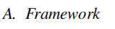
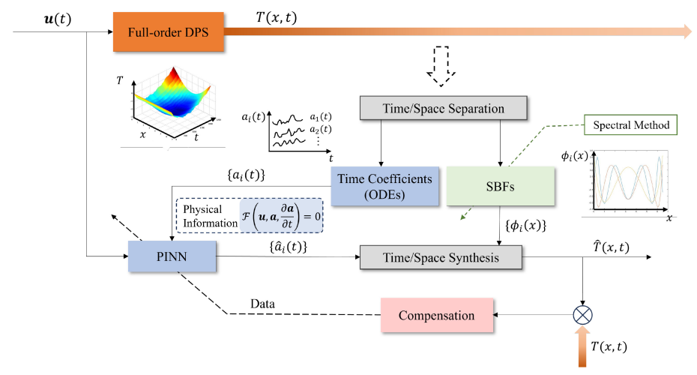
Method Design
Framework of T/S-PIML
CPS Computational Learning Laboratory
9
Notes:
空间和时间物理信息的提取这一步的核心是将复杂的、无限维的偏微分方程降阶简化为易于处理的常微分方程 。空间基函数提取：利用谱方法 从系统的控制方程、边界条件和相关条件中显式提取空间基函数，从而捕捉系统的空间物理特征 。时间物理信息表征：通过时间/空间分离，将原系统简化为一个由常微分方程组成的降阶系统，用于描述时间系数随时间演变的动态规律 。在获得降阶的 ODE 系统后，利用物理信息神经网络建立时间模型。网络架构：由全连接神经网络 (FCNN) 和损失函数两部分组成 。输入与输出：FCNN 的输入为时间变量 $t$ 和随时间变化的控制信号 $u$，输出为预测的时间系数 $a = \{a_i\}$ 6。物理损失函数：与直接求解复杂 PDE 的传统 PINN 不同，T/S-PIML 的物理信息由 ODEs 和初始条件 (ICs) 的残差提供 。利用自动微分 (AD) 获取时间系数的导数，并结合预先算出的空间基函数导数来计算残差，从而引导网络训练 。这种改进有效解决了传统 PINN 在处理高维、耦合时空信息时难以收敛的问题。3. 用于系统校准的数据补偿由于降阶模型和第一性原理理论与实际情况之间可能存在偏差，该方法引入了数据补偿机制。误差校正：在损失函数中加入数据损失项，利用少量的传感器实测数据对模型进行校准。紧凑集成：这种设计使得 PINN 能够无缝整合物理规律与实验数据，有效补偿建模误差、环境扰动以及时空分离带来的模型降阶误差。

Slide 10
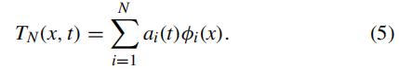
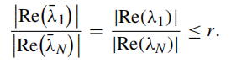
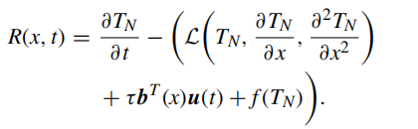
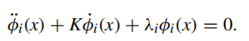
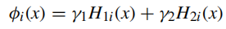
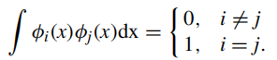
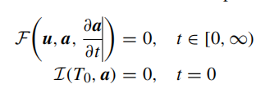
Method Design
(a) the time/space separation
(c) Extraction of Temporal Physical Information
(b) Extraction of Spatial Physical Information
CPS Computational Learning Laboratory
10
Notes:
首先假设分布式参数系统（DPS）的输出 $T(x, t)$ 可以展开为一系列空间基函数（SBFs）和时间系数的乘积之和. $a_i(t)$：代表时间物理信息（时间系数）。$\phi_i(x)$：代表空间物理信息（空间基函数）。 第二步，提取空间信息：Sturm-Liouville 特征值问题.为了得到 $\phi_i(x)$，作者对 PDE 的齐次版本进行变换，将其转化为一个 Sturm-Liouville 特征值问题。思路：通过求解这个方程并结合边界条件，可以得到一组正交的空间基函数（SBFs）.降阶：实际应用中，快速模态对系统的贡献很小，因此只需要保留前 $N$ 个慢速模态（Slow Modes），将无限维截断为有限维. 第三步：提取时间信息：Galerkin 投影法。得到空间基函数后，需要确定时间系数 $a_i(t)$ 随时间变化的规律。思路：将截断后的近似解 $T_N(x, t)$ 代入原始 PDE，产生残差 $R(x, t)$。正交投影：利用 Galerkin 方法，使残差与每一个空间基函数的内积为零。结果：这一步成功将 PDE 转化为了描述时间系数变化的 ODEs 降阶系统。

Slide 11
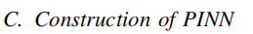
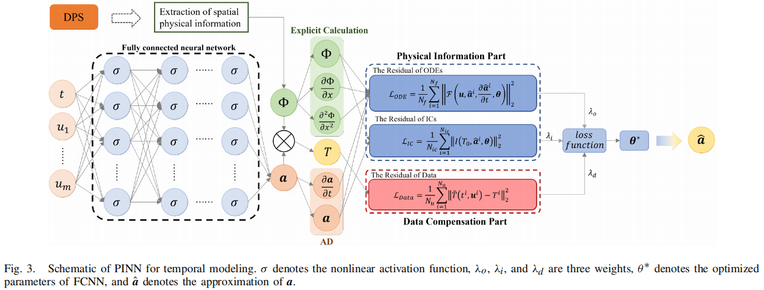
Method Design
1) Network Architecture
a) the fully connected neural network (FCNN) part and b) the loss function part.
CPS Computational Learning Laboratory
11
Notes:
网络架构：包含两部分：全连接神经网络 (FCNN) 和损失函数 8。输入：时间变量 $t$ 和控制输入信号 $u(t)$ 9999。输出：预测的时间系数 $\hat{a}_i(t)$ 10101010。物理损失函数 (Physical Loss Function)：这是该方法的创新点。不同于传统 PINN 直接求解复杂的 PDE 残差，T/S-PIML 的损失函数基于简化后的 ODE 残差和初始条件 (ICs) 。通过自动微分 (AD) 获取时间导数，并结合预先算好的空间基函数导数来计算残差。
网络架构：从图 3 可以看出，PINN 由两个部分组成：a) 全连接神经网络 (FCNN) 部分和 b) 损失函数部分。损失函数由物理信息部分和数据补偿部分组成。需要注意的是，PINN 的主要特点在于其能够以紧凑的方式将物理信息与数据无缝集成，这在单独的传统时空分离方法中是不易实现的。这一独特特性使 PINN 能够有效地补偿系统误差。数据补偿的细节将在下一节详细阐述。a) 在 FCNN 部分，我们利用了深度神经网络 (DNN) 众所周知的通用逼近能力。FCNN 的输入包括时间变量（即 $t$）和随时间变化的控制信号（即 $u$）。输出是时间系数（即 $a = \{a_i\}$）。b) 在物理信息部分，物理信息由常微分方程 (ODEs) 和初始条件 (ICs) 的残差提供。这些残差是通过将空间基函数 (SBFs)、FCNN 的输出（即近似的时间系数）及其导数代入 ODEs 和 ICs 计算得出的。归功于反向传播规则，时间系数的导数可以很容易地通过自动微分 (AD) 获取。此外，ODEs 中涉及的 SBFs 已通过谱方法获得，从而使其导数能够以较高的精度进行显式计算。

Slide 12
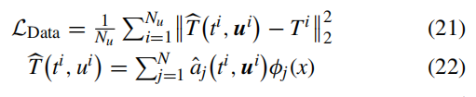
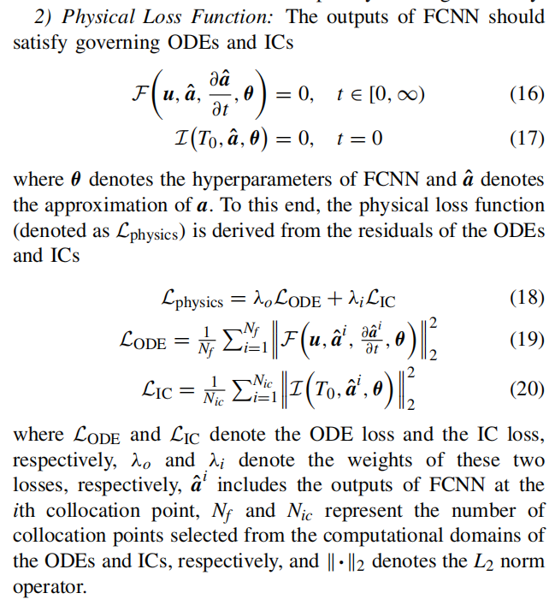
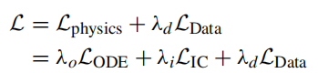
Method Design
CPS Computational Learning Laboratory
12

Slide 13
01
Problem Description
02
Method Design
03
Experiment Results
Contents
04
Conclusion
CPS Computational Learning Laboratory
13

Slide 14
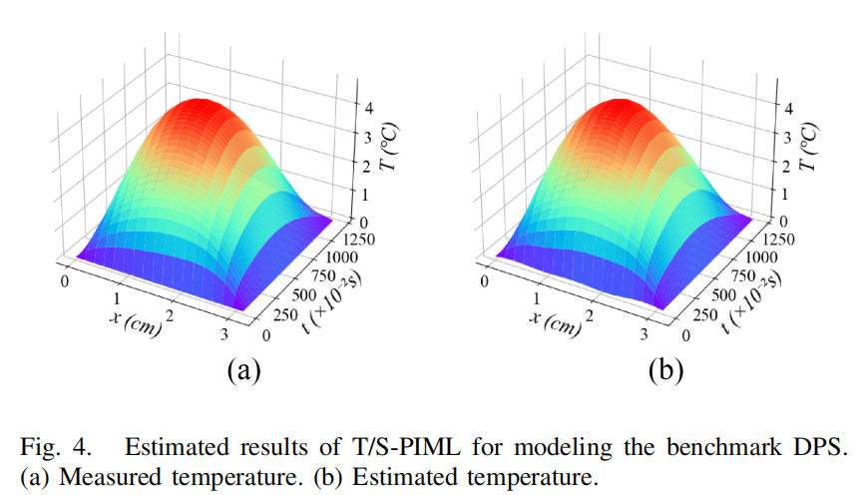
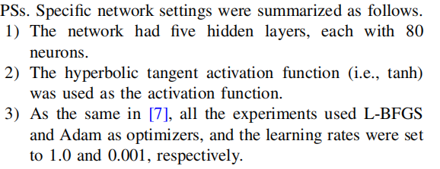
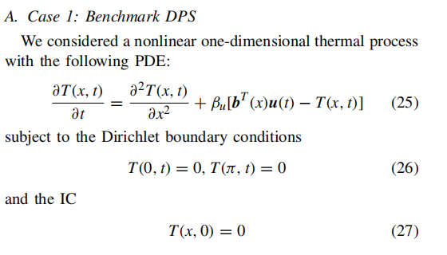
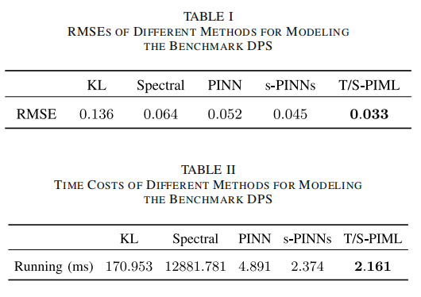
Experiment Results
CPS Computational Learning Laboratory
14
Notes:
构建了一个全连接神经网络 (FCNN) 来对分布参数系统 (DPS) 进行建模。网络架构：包含 5 个隐藏层，每层设有 80 个神经元 。激活函数：采用双曲正切激活函数 (tanh) 。优化器与学习率：使用 L-BFGS 和 Adam 优化器，学习率分别设定为 1.0 和 0.001 。为了验证 T/S-PIML 方法的有效性，作者准备了两组复杂的 DPS 模拟实验，并与四种主流方法进行对比：实验对象：基准 DPS 示例：用于性能评估的标准基准问题 。锂离子电池热过程：具有实际应用意义的真实物理过程建模 。对比方法：1) KL 方法；2) 谱方法；3) 常规 PINN；4) s-PINNs 。评价指标：采用均方根误差 (RMSE) 来衡量各建模方法的性能 。

Slide 15
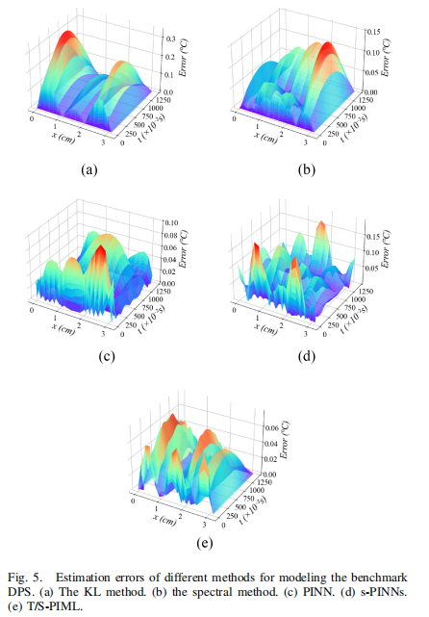
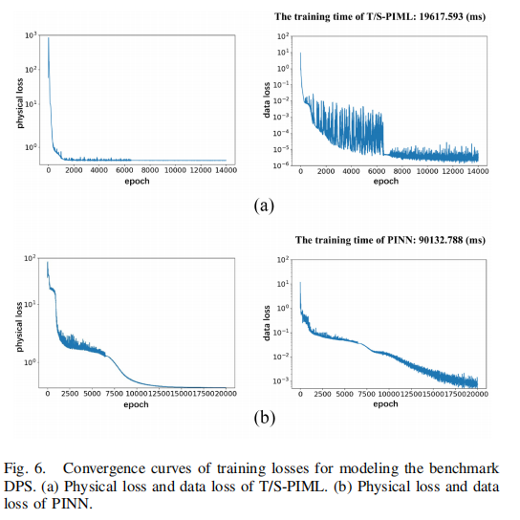
Experiment Results
CPS Computational Learning Laboratory
15
Notes:
构建了一个全连接神经网络 (FCNN) 来对分布参数系统 (DPS) 进行建模。网络架构：包含 5 个隐藏层，每层设有 80 个神经元 。激活函数：采用双曲正切激活函数 (tanh) 。优化器与学习率：使用 L-BFGS 和 Adam 优化器，学习率分别设定为 1.0 和 0.001 。为了验证 T/S-PIML 方法的有效性，作者准备了两组复杂的 DPS 模拟实验，并与四种主流方法进行对比：实验对象：基准 DPS 示例：用于性能评估的标准基准问题 。对比方法：1) KL 方法；2) 谱方法；3) 常规 PINN；4) s-PINNs 。评价指标：采用均方根误差 (RMSE) 来衡量各建模方法的性能 。

Slide 16
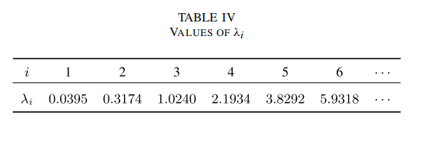
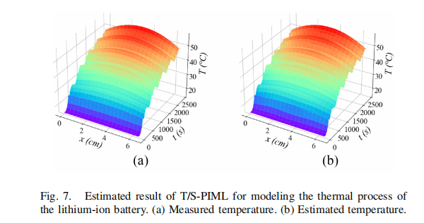
Experiment Results
CPS Computational Learning Laboratory
16
Notes:
锂离子电池热过程：具有实际应用意义的真实物理过程建模 。对比方法：1) KL 方法；2) 谱方法；3) 常规 PINN；4) s-PINNs 。评价指标：采用均方根误差 (RMSE) 来衡量各建模方法的性能 。

Slide 17
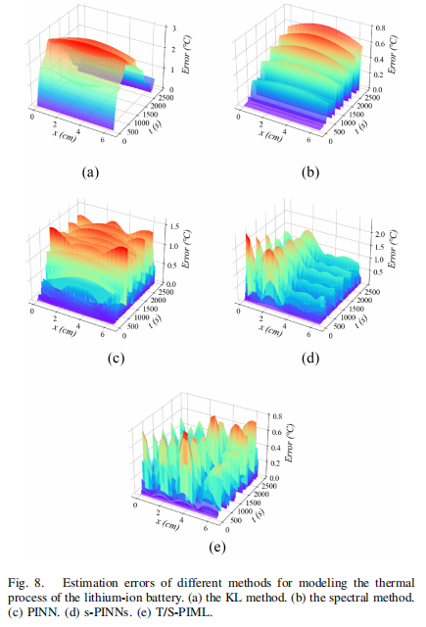
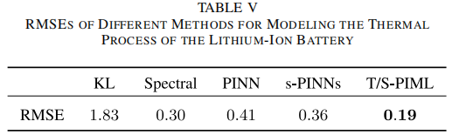
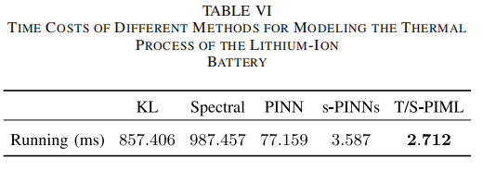
Experiment Results
CPS Computational Learning Laboratory
17
Notes:
锂离子电池热过程：具有实际应用意义的真实物理过程建模 。对比方法：1) KL 方法；2) 谱方法；3) 常规 PINN；4) s-PINNs 。评价指标：采用均方根误差 (RMSE) 来衡量各建模方法的性能 。

Slide 18
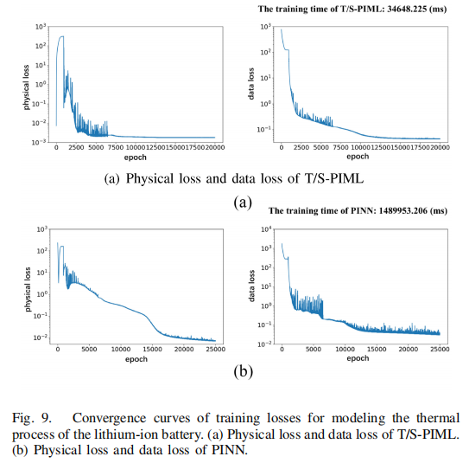
Experiment Results
CPS Computational Learning Laboratory
18
Notes:
锂离子电池热过程：具有实际应用意义的真实物理过程建模 。对比方法：1) KL 方法；2) 谱方法；3) 常规 PINN；4) s-PINNs 。评价指标：采用均方根误差 (RMSE) 来衡量各建模方法的性能 。

Slide 19
01
Problem Description
02
Method Design
03
Experiment Results
Contents
04
Conclusion
CPS Computational Learning Laboratory
19
CPS Computational Learning Laboratory
2
18

Slide 20
Conclusion
The T/S-PIML method integrates the spectral method with PINN to model distributed parameter systems. By decoupling PDEs into reduced-order ODEs, it significantly enhances training efficiency and convergence.
The T/S-PIML method achieves superior accuracy and robustness with limited data, as demonstrated in battery thermal modeling.
CPS Computational Learning Laboratory
20
Notes:
T/S-PIML 方法将谱方法与 PINN 整合，用于对分布参数系统进行建模 。通过将 PDE 解耦为降阶的 ODE 系统，显著提高了训练效率和收敛速度 。
该方法在数据有限的情况下实现了卓越的精度和鲁棒性，这一点在电池热建模等实验中得到了验证 。

Slide 21
Paper 2
Physics-Informed Adaptive-Weight NBeatsx for
Short-Term Wind Power Forecasting
Chunyu Li , Li Sheng , Senior Member, IEEE, Xiaopeng Xi , and Maiying Zhong
Publish Journal: IEEE TRANSACTIONS ON INDUSTRIAL INFORMATICS
Published Time: 2025
CPS Computational Learning Laboratory
21

Slide 22
01
Problem Description
02
Method Design
03
Experiment Results
Contents
04
Conclusion
CPS Computational Learning Laboratory
22

Slide 23
01
Problem Description
02
Method Design
03
Experiment Results
Contents
04
Conclusion
CPS Computational Learning Laboratory
23

Slide 24
Problem Description
The study addresses the challenges of short-term wind power forecasting (WPF), existing "closed-box" deep learning models lack physical interpretability and struggle with the volatility and intermittency of wind data. By integrating physical prior knowledge with a data-driven NBEATSx architecture.
The study aim to solve the joint optimization problem of enhancing forecast accuracy while ensuring the results remain physically rational and robust.
CPS Computational Learning Laboratory
24
Notes:
这项研究解决了短期风力发电预测（WPF）中面临的挑战，即传统的“黑盒”深度学习模型缺乏物理可解释性，且难以应对风力数据的波动性和间歇性 。通过将物理先验知识（风机运行约束）与数据驱动的 NBEATSx 架构相结合，研究人员旨在解决联合优化问题，即在提高预测准确性的同时，确保预测结果符合物理理性并具备鲁棒性 。

Slide 25
01
Problem Description
02
Method Design
03
Experiment Results
Contents
04
Conclusion
CPS Computational Learning Laboratory
25

Slide 26
Method Design
The study proposes a deep reinforcement learning-based dynamic scheduling approach for EOL product disassembly with stimuli-activated self-disassembly.
A constrained multi-agent deep reinforcement learning (C-QMIX) approach is developed to maximize the cumulative profit over a scheduling horizon, incorporating the dynamic batch mixing schemes in self-disassembly processes, uncertainties in returned product quality and residual values, failures and sequence changes in disassembly operations, and line-side buffer capacity constraints.
CPS Computational Learning Laboratory
26

Slide 27
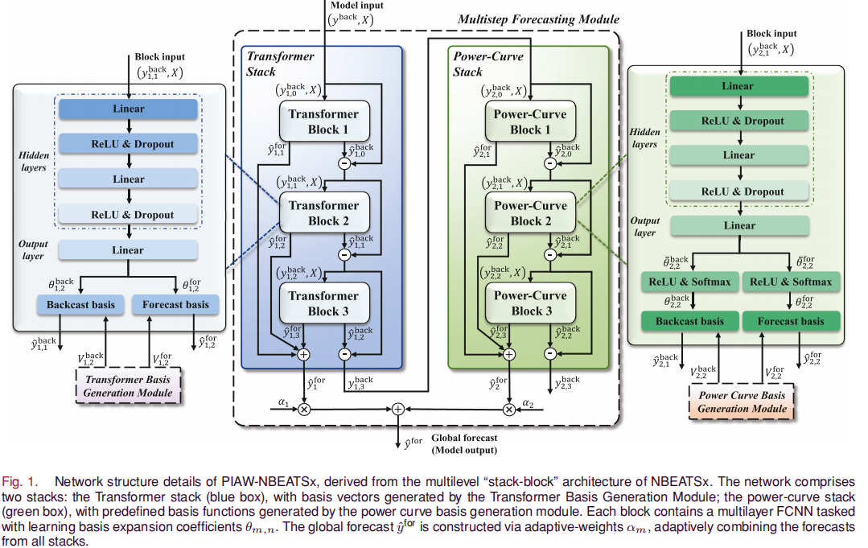
Method Design
CPS Computational Learning Laboratory
27
Notes:
核心架构：多层级堆叠设计.该模型基于 NBEATSx 的**“堆叠-区块” **多级架构进行改进 ，其逻辑如下：基础单元：网络的最基本结构单位，所有区块遵循相同的处理逻辑 。双残差连接：多个区块通过双残差原理连接形成堆叠（Stack），通过层层剥离已建模的信号分量，实现时间序列的结构化分解 。输入与输出:输入：包含回测窗口的动态残差分量和静态外部变量.输出：每个区块输出两个向量，分别是用于残差计算的“回测值” 和用于最终结果的“预测值” 。
系数学习（FCNN 层）：每个区块内含一个多层全连接神经网络，负责学习基底展开系数。这些系数本质上是分配给各个基底的权重，在训练过程中不断调整以实现强大的拟合性能 。基底层（Basis Layers）：通过求和操作将学习到的系数映射到回测和预测向量上 。基底可以是预定义的函数（物理约束），也可以是数据驱动学习到的基底向量 ⁹。堆叠专业化：每个堆叠专门处理特定类型的基底，例如文中提到的 Transformer 堆叠（捕获复杂时间依赖）和功率曲线堆叠（嵌入物理先验知识）。
这是 PIAW-NBEATSx 区别于传统模型的最关键思路：突破静态求和限制：传统 NBEATSx 采用静态聚合策略，即直接对所有区块输出求和（等权重），这限制了模型对复杂风电模式的动态适应能力.可训练权重矩阵（$\alpha_m$）：新架构引入了自适应权重系数 $\alpha_m$ .物理与数据的融合：模型根据输入特征动态调整每个堆叠（物理堆叠与数据驱动堆叠）对全局预测结果的贡献比例.这是 PIAW-NBEATSx 区别于传统模型的最关键思路：突破静态求和限制：传统 NBEATSx 采用静态聚合策略，即直接对所有区块输出求和（等权重），这限制了模型对复杂风电模式的动态适应能力.可训练权重矩阵（$\alpha_m$）：新架构引入了自适应权重系数 $\alpha_m$.物理与数据的融合：模型根据输入特征动态调整每个堆叠（物理堆叠与数据驱动堆叠）对全局预测结果的贡献比例。
[输入数据] $\rightarrow$ [多级区块/堆叠] $\rightarrow$ [学习基底系数 $\theta$] $\rightarrow$ [结合物理/时间基底] $\rightarrow$ [自适应权重 $\alpha$ 聚合] $\rightarrow$ [全局预测输出] ¹⁴

Slide 28
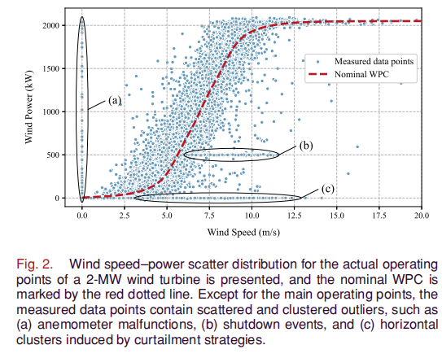
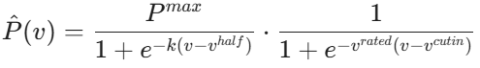
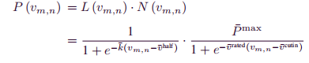
Method Design
(1) SLGM equation
(2) Scale the horizontal (wind speed) and vertical (power) coordinates of the SLGMs to the range [0,1]
CPS Computational Learning Laboratory
28
Notes:
B“功率曲线基底生成”.将风机的物理性能指标（切入/额定风速等）硬编码进模型，生成一组符合物理规律的“参考曲线”，再让神经网络通过学习来决定如何组合这些曲线以拟合实际数据。 SLGM 公式参数物理意义：
$P^{max}$：额定功率（最大功率输出） ²。
$v^{cutin}$ 和 $v^{rated}$：切入风速（开始发电）和额定风速（满载发电） ³。
$k$：陡峭度参数，控制曲线攀升的速度 ⁴。
$v^{half}$：半功率风速，即输出功率达到一半时的风速 ⁵。
组件功能：
第一个组件描述了功率随风速平滑增加的过程 ⁶。
第二个组件确保在切入风速 $v^{cutin}$ 之前功率接近 0，并在达到额定风速 $v^{rated}$ 后使功率趋于稳定（饱和） ⁷。
由于深度学习模型通常处理 $[0, 1]$ 范围的数据，论文在公式 (6) 中对风速和功率进行了标准化 ⁸：其中，所有风速参数都除以了“切断风速” $v^{cutout}$，而 $\bar{P}^{max}$ 设置为 。

Slide 29
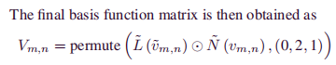
Method Design
CPS Computational Learning Laboratory
29
Notes:
为了让模型具有更强的表达能力，研究者不仅仅使用一条曲线，而是通过改变 $k$ 和 $v^{half}$ 的取值，生成了一组不同的曲线（基底）。计算过程（公式 7-10）：利用张量广播（Broadcasting）并行计算出所有可能的曲线组合。最终通过公式 (10) 得到基底矩阵 $V_{m,n}$ ：
这个矩阵包含了 $D = n_k \times n_v$ 个不同的功率曲线候选形状.
对于学习到的系数 $\theta$（即分配给每个物理基底的权重），模型通过公式 (12) 进行处理. ReLU：确保权重为非负数，符合物理出力的逻辑（风电功率不能为负） 。oftmax：对权重进行归一化，使得所有物理基底的贡献总和受限，增强了模型的稳定性 。

Slide 30
Method Design
CPS Computational Learning Laboratory
30
Notes:
Transformer 基底生成.利用 Transformer 捕获复杂的时间依赖性，作为物理模型的补充。嵌入与位置编码.利用缩放因子 $\sqrt{d_{m,n}}$ 来稳定梯度 ¹³。公式 (14)：将位置编码（PE）与嵌入特征相加，使模型感知时间顺序 。 编码器处理 (15)：通过多头自注意力机制（Multi-head Self-attention）提取深层时间特征 。将 Transformer 的输出通过投影层与原始特征融合：这保证了即使经过深层特征提取，原始的物理观测信息流（如实时风速）依然能直接影响最终的基底向量 。

Slide 31
01
Problem Description
02
Method Design
03
Experiment Results
Contents
04
Conclusion
CPS Computational Learning Laboratory
31

Slide 32
Experiment Results
Data Source: Used SCADA real-time monitoring data from a wind farm in China for the year 2023, with a sampling frequency of 15 minutes.
Feature Selection: 13 exogenous variables, including wind speed, phase voltage, blade angle, and environmental temperature, were selected through Pearson correlation coefficients.
Evaluation Metrics: Adopted MAPE, SMAPE, NMAE, NMSE, and R2 to measure forecasting accuracy across multiple dimensions.
Window Configuration: The backcast window L1 was set to 25 time steps (5 hours of data), and the forecast window L2 was set to 5 time steps (75-minute forecast).
Data Partitioning: The ratio of training set, validation set, and test set was 6:2:2.
Optimization Parameters: Used the Adam optimizer, set the hidden layer dimension to 64 and the learning rate to 0.002, and incorporated Dropout (0.2) to prevent overfitting.
CPS Computational Learning Laboratory
32

Slide 33
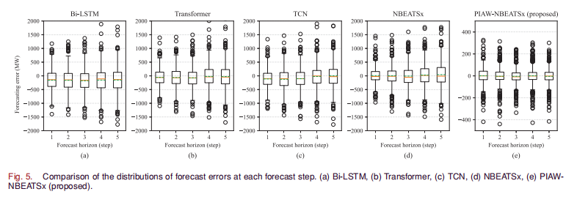
Experiment Results
CPS Computational Learning Laboratory
33

Slide 34
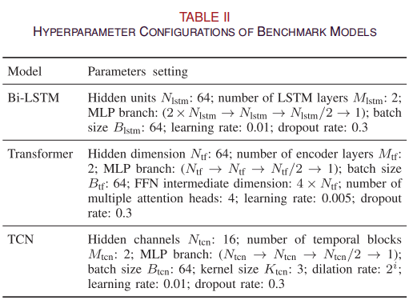
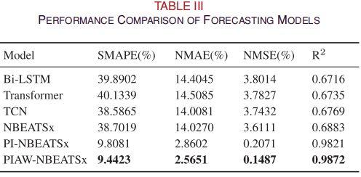
Experiment Results
CPS Computational Learning Laboratory
34

Slide 35
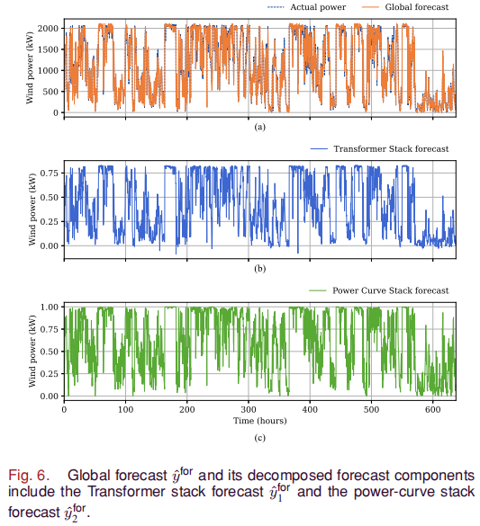
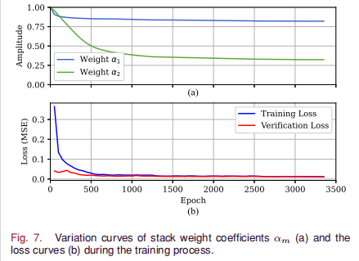
Experiment Results
CPS Computational Learning Laboratory
35

Slide 36
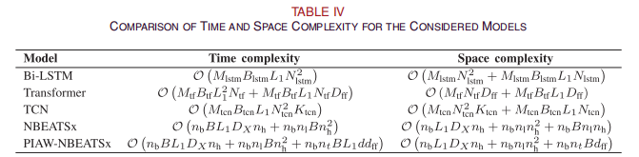
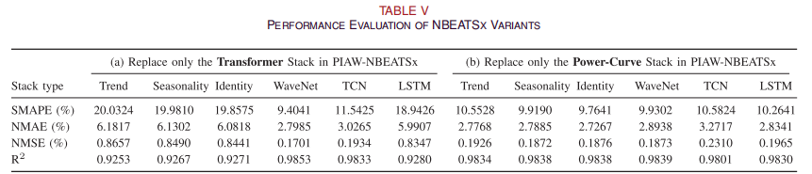
Experiment Results
CPS Computational Learning Laboratory
36

Slide 37
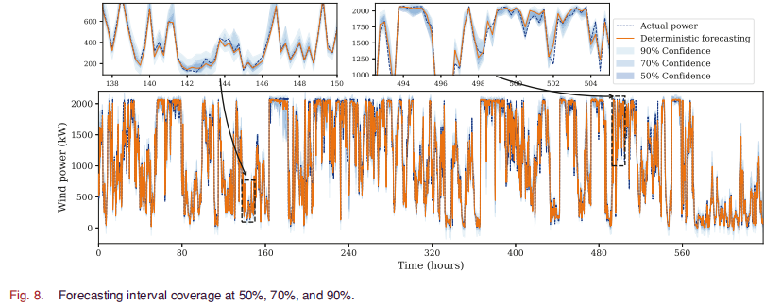
Experiment Results
CPS Computational Learning Laboratory
37

Slide 38
01
Problem Description
02
Method Design
03
Experiment Results
Contents
04
Conclusion
CPS Computational Learning Laboratory
38
CPS Computational Learning Laboratory
2
18

Slide 39
Conclusion
The study introduces PIAW-NBEATSx, a novel short-term wind power forecasting framework that integrates physical priors with data-driven deep learning. By embedding wind turbine operational constraints into a Power-Curve stack and leveraging a Transformer stack for temporal dependencies, the model ensures physical consistency. A key innovation is the dynamic trainable weighting mechanism, which adaptively balances stack contributions.
CPS Computational Learning Laboratory
39

Slide 40
Paper 3
Robust Power System State Estimation Using
Physics-Informed Neural Networks
Solon Falas , Markos Asprou , Member, IEEE, Charalambos Konstantinou , Senior Member, IEEE,
and Maria K. Michael , Member, IEEE
Publish Journal: IEEE TRANSACTIONS ON INDUSTRIAL INFORMATICS
Published Time: 2025
CPS Computational Learning Laboratory
40
Notes:
动态：机器人工作站拆解失败

Slide 41
01
Problem Description
02
Method Design
03
Experiment Results
Contents
04
Conclusion
CPS Computational Learning Laboratory
41

Slide 42
01
Problem Description
02
Method Design
03
Experiment Results
Contents
04
Conclusion
CPS Computational Learning Laboratory
42

Slide 43
Problem Description
To address critical challenges in modern power system state estimation, including slow response speeds, low accuracy under faulty conditions, and vulnerability to cyber-attacks such as false data injection.
CPS Computational Learning Laboratory
43

Slide 44
01
Problem Description
02
Method Design
03
Experiment Results
Contents
04
Conclusion
CPS Computational Learning Laboratory
44

Slide 45
Method Design
The study proposes a physics-informed neural network (PINN) framework for power system state estimation. By embedding physical laws like Kirchhoff's equations into the loss function, it enhances accuracy and robustness during faults and cyber-attacks.
CPS Computational Learning Laboratory
45
Notes:
MOPPO学习不同偏好（优化目标权重）下的策略

Slide 46
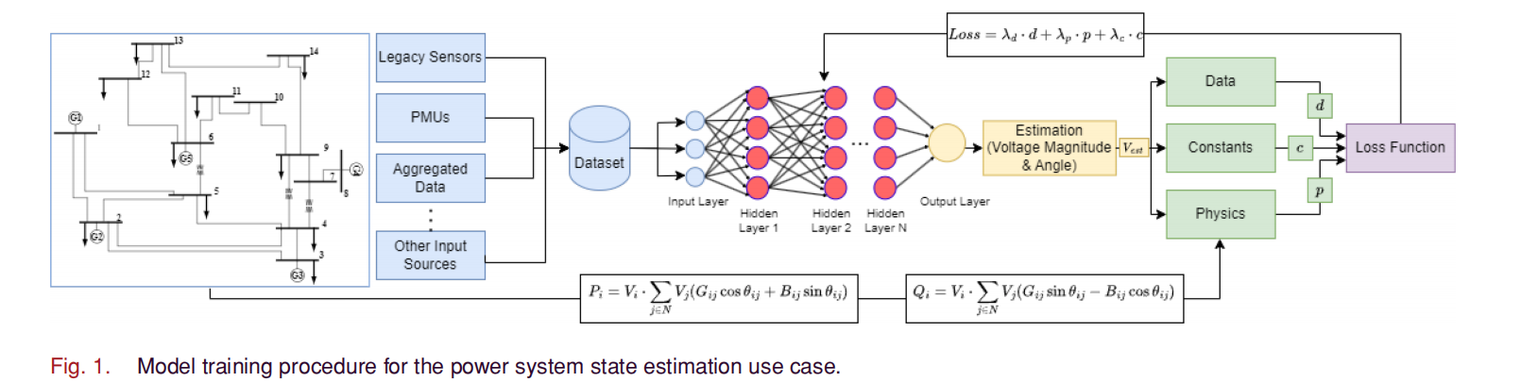
Method Design
CPS Computational Learning Laboratory
46
Notes:
左图：拆解电冰箱的任务约束，对应的先序约束图矩阵
右图：表格是每个任务对应的拆解时间、危险和优先级标识

Slide 47
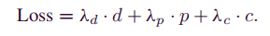
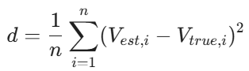
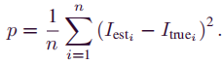
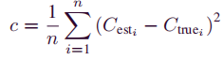
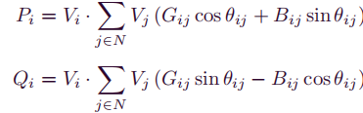
Method Design
The active and reactive power injections are calculated using the following equations:
CPS Computational Learning Laboratory
47
Notes:
这部分（Section III-C）介绍了 PINN 模型的核心物理基础，即如何通过功率流方程将输入数据与输出状态联系起来。
1. 输入与输出的选择:输入变量：选择各节点的有功功率 ($P_i$) 和无功功率 ($Q_i$) 注入测量值作为输入。输出变量：模型的输出是估计的复电压，即每个节点的电压幅值 ($V_i$) 和相角 ($\theta_i$)。选择原因：功率注入测量值能够通过数据驱动的模式揭示系统的拓扑结构。
3.数据损失项:d用于确保模型的预测值与“地面真值”（真实数据）一致.估计电压（幅值和相角）与真实电压之间的均方误差（MSE）.物理约束项p:通过预测电压计算出的电流 $I_{est}$ ¹⁰与真实电流 $I_{true}$ ¹¹之间的均方误差。这强制模型必须遵守电网拓扑结构 ¹²。系统常数项c:预测值与已知物理常数之间的均方误差.

Slide 48
01
Problem Description
02
Method Design
03
Experiment Results
Contents
04
Conclusion
CPS Computational Learning Laboratory
48

Slide 49
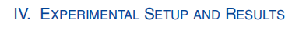
Experiment Results
Test Systems: Simulations conducted using the standard IEEE 14-bus and IEEE 118-bus benchmark systems.
Data Generation: Realistic power system scenarios were generated using PowerWorld software.
Tech Stack: Implemented in Python using TensorFlow for efficient neural network training.
Noise Handling: Simulated measurement noise was injected into the datasets to emulate inherent inaccuracies and stochastic fluctuations of real-world sensors, thereby improving model robustness.
Computing Resources: All measurements and training were performed on a single NVIDIA RTX 4000 Ada Generation GPU.
CPS Computational Learning Laboratory
49

Slide 50
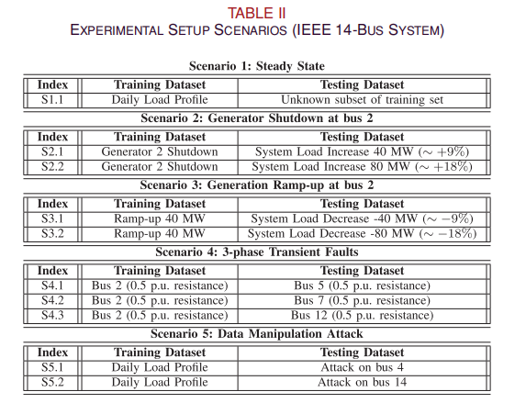
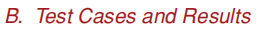
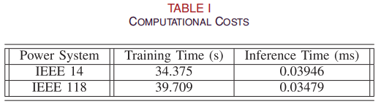
Experiment Results
CPS Computational Learning Laboratory
50

Slide 51
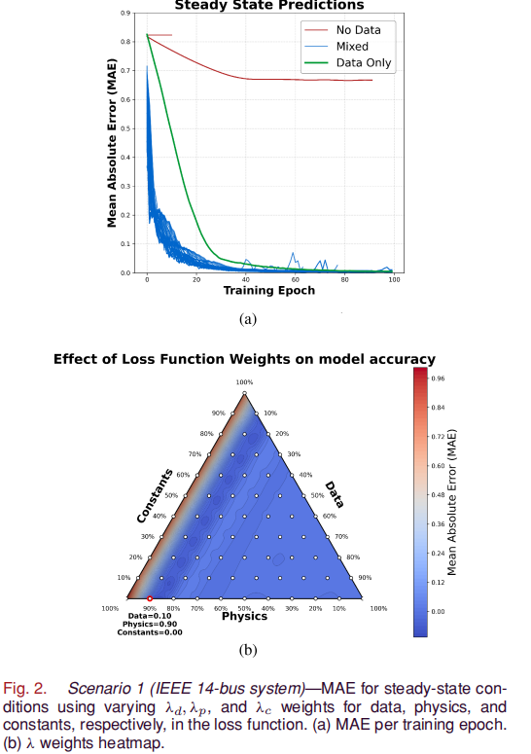
Experiment Results
CPS Computational Learning Laboratory
51

Slide 52

Experiment Results
CPS Computational Learning Laboratory
52

Slide 53


Experiment Results
CPS Computational Learning Laboratory
53

Slide 54


Experiment Results
CPS Computational Learning Laboratory
54

Slide 55
01
Problem Description
02
Method Design
03
Experiment Results
Contents
04
Conclusion
CPS Computational Learning Laboratory
55
CPS Computational Learning Laboratory
2
18

Slide 56
Conclusion
The study proposes a PINN framework for power system state estimation. By embedding physical laws into the loss function and employing systematic hyperparameter optimization , the study enhances accuracy and robustness against faults and cyber-attacks compared to traditional models.
CPS Computational Learning Laboratory
56

Slide 57
Paper 4
Physics-Informed Evidential Network: A General
Framework for Uncertainty Evaluation in Nonlinear
Dynamic Measurement Systems
Wenhao Chen , Yinye Ding , Rencheng Song , Senior Member, IEEE, Chengliang Pan , Huining Zhao ,
Hongli Li , and Haojie Xia , Member, IEEE
Published in: IEEE TRANSACTIONS ON INSTRUMENTATION AND MEASUREMENT
Published Time: 2025
CPS Computational Learning Laboratory
57
Notes:
人的不确定性：拆解时间和拆解任务选择不确定，会影响后续任务的调度

Slide 58
01
Problem Description
02
Method Design
03
Experiment Results
Contents
04
Conclusion
CPS Computational Learning Laboratory
58

Slide 59
01
Problem Description
02
Method Design
03
Experiment Results
Contents
04
Conclusion
CPS Computational Learning Laboratory
59

Slide 60
Problem Description
Evaluating uncertainty in nonlinear dynamic systems is challenging due to model complexity and unmodeled disturbances. Existing methods lack physical interpretability or suffer from high computational costs. Existing deep learning models often fail to provide reliable uncertainty assessments when governing equations contain unknown variables or missing components.
CPS Computational Learning Laboratory
60

Slide 61
01
Problem Description
02
Method Design
03
Experiment Results
Contents
04
Conclusion
CPS Computational Learning Laboratory
61

Slide 62
Method Design
PIENet integrates governing differential equations as physical priors into a dual-branch neural network.
PIENet employs deep evidential regression to capture total uncertainty in a single forward pass.
By combining physics-based residuals with uncertainty-aware loss, PIENet maintains consistency even with unknown variables.
CPS Computational Learning Laboratory
62

Slide 63

Method Design
CPS Computational Learning Laboratory
63

Slide 64







Method Design
CPS Computational Learning Laboratory
64

Slide 65
01
Problem Description
02
Method Design
03
Experiment Results
Contents
04
Conclusion
CPS Computational Learning Laboratory
65

Slide 66


Experiment Results
CPS Computational Learning Laboratory
66

Slide 67


Experiment Results
CPS Computational Learning Laboratory
67

Slide 68


Experiment Results
CPS Computational Learning Laboratory
68

Slide 69

Experiment Results
CPS Computational Learning Laboratory
69

Slide 70

Experiment Results
CPS Computational Learning Laboratory
70

Slide 71


Experiment Results
CPS Computational Learning Laboratory
71

Slide 72


Experiment Results
CPS Computational Learning Laboratory
72

Slide 73
01
Problem Description
02
Method Design
03
Experiment Results
Contents
04
Conclusion
CPS Computational Learning Laboratory
73
CPS Computational Learning Laboratory
2
18

Slide 74
Conclusion
TPIENet integrates governing differential equations as physical priors into an evidential network.
TPIENet quantifies data and model uncertainty through single-pass deep evidential regression.
TPIENet enhances predictive accuracy and robustness in nonlinear dynamic systems, even when governing equations contain unknown variables.
CPS Computational Learning Laboratory
74

Slide 75
Paper 5
Physics-Informed Passive Motion Paradigm for
Parallel Robots: A High-Precision Motor-Primitives Framework
Fuli Wang, Fazair Nizar Siraj, Windo Hutabarat, and Ashutosh Tiwari
Publish Journal: IEEE ROBOTICS AND AUTOMATION LETTERS
Published Time: 2025
CPS Computational Learning Laboratory
75
Notes:
动态：人的不确定性，全局任务信息未知的不确定性

Slide 76
01
Problem Description
02
Method Design
03
Experiment Results
Contents
04
Conclusion
CPS Computational Learning Laboratory
76

Slide 77
01
Problem Description
02
Method Design
03
Experiment Results
Contents
04
Conclusion
CPS Computational Learning Laboratory
77

Slide 78
Problem Description
Parallel robots face challenges in motion generation due to nonlinear, over-constrained kinematics. Conventional numerical or ANN-based methods often lack physical interpretability and suffer from numerical instability or poor generalization.
The study proposes a high-precision physics-informed neural network (PINN) within the Passive Motion Paradigm (PMP) to ensure physical consistency and robust control.
CPS Computational Learning Laboratory
78

Slide 79
01
Problem Description
02
Method Design
03
Experiment Results
Contents
04
Conclusion
CPS Computational Learning Laboratory
79

Slide 80
Method Design
The study integrates PINN with the Passive Motion Paradigm (PMP).
The study embeds rigid-body transformations into a self-supervised neural field to estimate the Jacobian matrix. Motion is generated as a dynamic unfolding of motor primitives driven by virtual attractor fields.
CPS Computational Learning Laboratory
80

Slide 81

Method Design
CPS Computational Learning Laboratory
81

Slide 82







Method Design
(3) the inverse Jacobian matrix
(1) The transformed position of an attachment point on the moving platform in the global frame is given by:
(2) The leg length:
CPS Computational Learning Laboratory
82
Notes:
1、开始
2、将任务Tn分配给人或者机器
3、完成任务
4、判断是否存在可加工的任务
是：回到2
否：等待人或者机器人完成任务
5、判断当前层的所有任务是否都完成了
是：进入下一层拆解任务
否：人工再确认

Slide 83

Method Design
CPS Computational Learning Laboratory
83

Slide 84
01
Problem Description
02
Method Design
03
Experiment Results
Contents
04
Conclusion
CPS Computational Learning Laboratory
84

Slide 85

Experiment Results
CPS Computational Learning Laboratory
85

Slide 86

Experiment Results
CPS Computational Learning Laboratory
86

Slide 87



Experiment Results
CPS Computational Learning Laboratory
87

Slide 88
01
Problem Description
02
Method Design
03
Experiment Results
Contents
04
Conclusion
CPS Computational Learning Laboratory
88
CPS Computational Learning Laboratory
2
18

Slide 89
Conclusion
The study introduces a high-precision PINN-PMP framework for parallel robots.
By embedding rigid-body transformations into a self-supervised neural field, the study ensures physical consistency and stable Jacobian estimation.
Simulations and experiments demonstrate sub-micrometer accuracy and superior robustness compared to standard neural networks.
CPS Computational Learning Laboratory
89

Slide 90
Research Inspiration
Integrating spatiotemporal decoupling strategies, adaptive-weight mechanisms, and deep evidential learning enables deep learning to overcome PINN limitations in managing high-dimensional complex systems, nonlinear dynamics, and uncertainty evaluations. Such integration maintains exceptional computational efficiency and physical consistency even under conditions of data scarcity or external interference.
CPS Computational Learning Laboratory
90
Notes:
通过引入时空解耦策略 、自适应权重机制 及证据深度学习 ，深度学习克服了 PINN 在处理高维复杂系统、非线性动力学及不确定性评估时的局限。这种深度融合，使模型在样本稀缺或存在干扰的情况下，依然能保持极高的计算效率与物理一致性

Slide 91
Thank you for listening

